Slide 1
Skills Bootcamp Classroom Rules
Be on time: Just like in a physical classroom, it's important to be punctual for your online class. Log in to the virtual classroom a few minutes before the class starts.
Turn Cameras on: In order to maximise your learning studies show that being able to see your peers and your tutor being able to see you can increase motivations and retention, therefore we ask to keep your cameras on.
Attend all classes: In order to be successful in your bootcamp studies you need to attend all live sessions, therefore you should prioritise and make time for these sessions.
Avoid distractions: Turn off your phone notifications, close any other unnecessary tabs, and focus solely on the class.
Participate actively: It's important to be an active participant in the class. Ask questions, answer questions, and participate in discussions.
Use proper language and tone: Use respectful language and tone when communicating with your classmates and instructor. Avoid using slang or inappropriate language.
Respect others' opinions: Be respectful of others' opinions, even if they differ from your own. Avoid making negative comments or attacking others.
Follow the instructor's guidelines: Follow the instructor's guidelines, such as submitting assignments on time.
Be polite: Be polite and respectful to everyone in the class, including the instructor, classmates, and guest speakers.
Dress appropriately: Even though you are not in a physical classroom, it's important to dress appropriately. Dress as if you were going to a face-to-face class.
Use appropriate technology: Ensure that you have the necessary equipment, such as a reliable internet connection, a microphone, and a webcam, and that they are in good working condition.

Slide 2
Software Developer Bootcamp
Unit 3 – Coding and Architecture
Week 7B

Slide 3
Objectives
Following this session, you should be able to:
Identify Key Security Vulnerabilities in Software Development
Demonstrate the Implementation of Security Best Practices in Code
Evaluate the Impact of Security Measures on Software Performance and Usability
Understand and apply nested selection

Slide 4
Think, write, pair, share
1 2 3 4 5 6 7 | print("Username: ") username = input() if username == "Eirini": print("Password: ") password = input() if password == "Fish4321": print("Access granted")
Question .
Explain exactly what you think will happen when this code is executed.
Think about...
What would happen if Ben was entered for the username?
What would happen if Eirini was entered for the username?
What exactly needs to be inputted to gain access to the system?

Slide 5

Nested selection: definition
When a selection block is placed within another selection block, it is called nested selection.
Any type of selection block can be nested inside a selection block.

Slide 6
Nested selection: example structures
if :
if :
if :
condition
condition
condition
block of statements
block of statements
block of statements
if :
if :
else:
if :
elif :
else:
condition
condition
condition
block of statements
block of statements
block of statements
condition
block of statements
block of statements
block of statements

Slide 7
Nested selection: walkthrough
State .
1 2 3 4 5 6 7 8 9 10 | print("Username: ") username = input() if username == "Eirini": print("Password: ") password = input() if password == "Fish4321": print("Access granted") print("...program closing")
username
password
Input/output .
Username:

Slide 8
Nested selection: walkthrough
State .
1 2 3 4 5 6 7 8 9 10 | print("Username: ") username = input() if username == "Eirini": print("Password: ") password = input() if password == "Fish4321": print("Access granted") print("...program closing")
username
Ben
password
Input/output .
Username:
Ben

Slide 9
Nested selection: walkthrough
State .
1 2 3 4 5 6 7 8 9 10 | print("Username: ") username = input() if username == "Eirini": print("Password: ") password = input() if password == "Fish4321": print("Access granted") print("...program closing")
username
Ben
password
False
Input/output .
Username:
Ben

Slide 10
Nested selection: walkthrough
State .
1 2 3 4 5 6 7 8 9 10 | print("Username: ") username = input() if username == "Eirini": print("Password: ") password = input() if password == "Fish4321": print("Access granted") print("...program closing")
username
Ben
password
Input/output .
Username:
Ben
...program closing
>>>

Slide 11
Nested selection: walkthrough
State .
1 2 3 4 5 6 7 8 9 10 | print("Username: ") username = input() if username == "Eirini": print("Password: ") password = input() if password == "Fish4321": print("Access granted") print("...program closing")
username
password
Input/output .
Username:

Slide 12
Nested selection: walkthrough
State .
1 2 3 4 5 6 7 8 9 10 | print("Username: ") username = input() if username == "Eirini": print("Password: ") password = input() if password == "Fish4321": print("Access granted") print("...program closing")
username
Eirini
password
Input/output .
Username:
Eirini

Slide 13
Nested selection: walkthrough
State .
1 2 3 4 5 6 7 8 9 10 | print("Username: ") username = input() if username == "Eirini": print("Password: ") password = input() if password == "Fish4321": print("Access granted") print("...program closing")
username
Eirini
password
True
Input/output .
Username:
Eirini

Slide 14
Nested selection: walkthrough
State .
1 2 3 4 5 6 7 8 9 10 | print("Username: ") username = input() if username == "Eirini": print("Password: ") password = input() if password == "Fish4321": print("Access granted") print("...program closing")
username
Eirini
password
Input/output .
Username:
Eirini
Password:

Slide 15
Nested selection: walkthrough
State .
1 2 3 4 5 6 7 8 9 10 | print("Username: ") username = input() if username == "Eirini": print("Password: ") password = input() if password == "Fish4321": print("Access granted") print("...program closing")
username
Eirini
password
Bob
Input/output .
Username:
Eirini
Password:
Bob

Slide 16
Nested selection: walkthrough
State .
1 2 3 4 5 6 7 8 9 10 | print("Username: ") username = input() if username == "Eirini": print("Password: ") password = input() if password == "Fish4321": print("Access granted") print("...program closing")
username
Eirini
password
Bob
Input/output .
Username:
Eirini
Password:
Bob
False

Slide 17
Nested selection: walkthrough
State .
1 2 3 4 5 6 7 8 9 10 | print("Username: ") username = input() if username == "Eirini": print("Password: ") password = input() if password == "Fish4321": print("Access granted") print("...program closing")
username
Eirini
password
Bob
Input/output .
Username:
Eirini
Password:
Bob
...program closing
>>>

Slide 18
Key Security Vulnerabilities in Software Development

Slide 19

What is a Security Vulnerability?
A security vulnerability is a weakness in a system or application that can be exploited by an attacker to gain unauthorized access to sensitive data or resources.
Vulnerabilities can be caused by a variety of factors, including poor coding practices, inadequate security controls, and lack of user awareness.

Slide 20
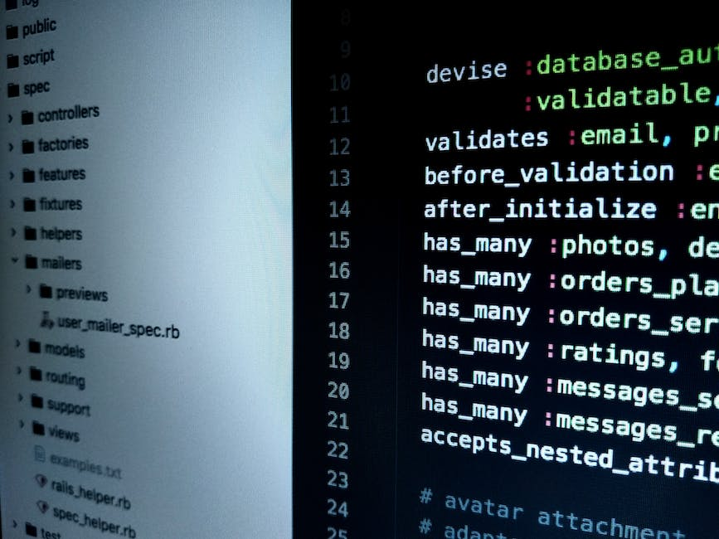
Types of Security Vulnerabilities
Buffer Overflow: A buffer overflow occurs when a program attempts to write more data to a buffer than it can hold, resulting in data corruption.
SQL Injection: SQL injection is a type of attack that allows an attacker to execute malicious SQL statements on a database.
Cross-Site Scripting (XSS): XSS is a type of attack that allows an attacker to inject malicious code into a web page or application.

Slide 21

Preventing Security Vulnerabilities
Implement secure coding practices: Secure coding practices can help reduce the risk of security vulnerabilities by ensuring that code is written in a secure manner.
Perform regular security testing: Regular security testing can help identify potential security vulnerabilities before they are exploited by an attacker.
Educate users on security best practices: Educating users on security best practices can help reduce the risk of security vulnerabilities by ensuring that users are aware of the risks and how to protect themselves.

Slide 22

Common Security Vulnerabilities
Insecure Storage: Insecure storage of sensitive data can lead to data leakage and other security issues.
Insecure Communication: Insecure communication can lead to data interception and other security issues.
Insecure Authentication: Insecure authentication can lead to unauthorized access and other security issues.

Slide 23

Detecting Security Vulnerabilities
Static Analysis: Static analysis is a process of analyzing source code to identify potential security vulnerabilities.
Dynamic Analysis: Dynamic analysis is a process of analyzing an application while it is running to identify potential security vulnerabilities.
Penetration Testing: Penetration testing is a process of attempting to exploit security vulnerabilities to identify potential security issues.

Slide 24

Mitigating Security Vulnerabilities
Patch Management: Patch management is the process of applying security patches to address known security vulnerabilities.
Security Monitoring: Security monitoring is the process of monitoring systems and applications for suspicious activity.
Security Awareness Training: Security awareness training is the process of educating users on security best practices to reduce the risk of security vulnerabilities.

Slide 25

Responding to Security Vulnerabilities
Containment: Containment is the process of isolating a system or application to prevent further exploitation of a security vulnerability.
Remediation: Remediation is the process of addressing the root cause of a security vulnerability to prevent future exploitation.
Notification: Notification is the process of informing affected users and stakeholders of a security vulnerability and the steps taken to address it.

Slide 26

Conclusion
Security vulnerabilities can have serious consequences for software applications and systems.
By understanding the different types of security vulnerabilities, implementing secure coding practices, performing regular security testing, and educating users on security best practices, organizations can reduce the risk of security vulnerabilities and protect their software applications and systems.

Slide 27
Implementation of Security Best Practices in Code

Slide 28

What is Security Best Practices?
Security best practices are a set of guidelines and standards that help developers create secure code.
These practices are designed to reduce the risk of security vulnerabilities in code and protect against malicious attacks.

Slide 29

Why is Security Best Practices Important?
Security best practices are important because they help protect against malicious attacks and reduce the risk of security vulnerabilities in code.
By following these practices, developers can ensure that their code is secure and their applications are protected.

Slide 30
Implementing Security Best Practices
Implementing security best practices in code involves a number of steps, including:
- Identifying and addressing potential security vulnerabilities
- Writing secure code
- Testing code for security vulnerabilities
- Monitoring code for security issues

Slide 31
Secure Coding Practices
Secure coding practices include:
- Using secure coding standards and guidelines
- Writing secure code
- Testing code for security vulnerabilities
- Monitoring code for security issues

Slide 32
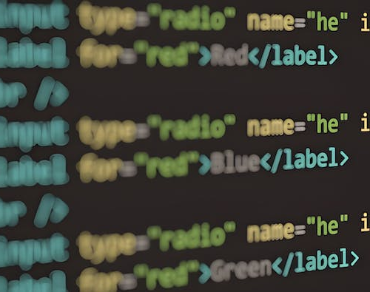
Secure Coding Tools
Secure coding tools include:
- Static code analysis tools
- Dynamic code analysis tools
- Security testing tools
- Security monitoring tools

Slide 33
Secure Coding Guidelines
Secure coding guidelines include:
- Avoiding insecure coding practices
- Using secure coding standards
- Writing secure code
- Testing code for security vulnerabilities

Slide 34

Secure Coding Standards
Secure coding standards include:
- OWASP Top 10
- SANS Top 25
- CERT Secure Coding
- Microsoft Security Development Lifecycle

Slide 35

Secure Coding Practices
Secure coding practices provide a number of benefits, including:
- Reduced risk of security vulnerabilities
- Improved application security
- Increased customer trust and confidence
- Reduced costs associated with security breaches

Slide 36

Conclusion
Implementing security best practices in code is essential for protecting against malicious attacks and reducing the risk of security vulnerabilities.
By following secure coding practices, developers can ensure that their code is secure and their applications are protected.

Slide 37
Impact of Security Measures on Software Performance and Usability

Slide 38

What is Security?
Definition of Security: Security in software development refers to the practices and measures taken to protect software applications from unauthorised access, data breaches, and other cyber threats.
Types of Security Measures: Security measures in software development can be broadly categorised into preventive, detective, and corrective measures, each serving a unique purpose in the security lifecycle.
Examples of Security Measures: Common examples of security measures include firewalls, encryption, two-factor authentication, and regular software patches to address vulnerabilities.

Slide 39

Impact on Performance
How Security Measures Affect Performance: Implementing robust security measures, such as encryption and multi-factor authentication, can sometimes introduce latency or consume additional system resources, affecting overall performance.
Examples of Performance Impacts: For instance, enabling full-disk encryption can slow down data read/write speeds, while complex authentication processes may lengthen the user login time.
Measuring Performance Impacts: To accurately gauge the impact of security measures on performance, key performance indicators like load time, response time, and system resource usage should be monitored before and after implementation.

Slide 40

Impact on Usability
How Security Measures Affect Usability: Implementing robust security measures can sometimes add extra steps for users, potentially impacting the overall usability of a software application.
Examples of Usability Impacts: For instance, multi-factor authentication, while enhancing security, may slow down the login process and frustrate some users.
Measuring Usability Impacts: Usability impacts can be quantified through user satisfaction surveys, time taken to complete tasks, and the successful completion rate.

Slide 41

Balancing Security and Performance
The importance of finding the right balance between security and performance
Examples of balancing security and performance
Measuring the balance between security and performance

Slide 42

Balancing Security and Usability
The importance of finding the right balance between security and usability
Examples of balancing security and usability
Measuring the balance between security and usability

Slide 43

Security Best Practices
Best Practices for Security Measures: Implementing best practices, such as regular patch management and multi-factor authentication, is crucial for safeguarding an organisation's data and systems.
Examples of Security Best Practices: Some of security best practices include using strong, unique passwords, keeping software up-to-date, and conducting regular security audits.
Measuring the Effectiveness of Security Best Practices: The effectiveness of security best practices can be measured through key performance indicators like the frequency of security incidents, time taken to detect and respond to threats, and user compliance rates.

Slide 44

Performance Best Practices
Best Practices for Performance Optimization: Implementing best practices for performance optimisation, such as code minification and lazy loading, is crucial for enhancing the speed and responsiveness of software applications.
Examples of Performance Best Practices: Caching frequently accessed data, optimising database queries and compressing images are performance best practices that can significantly improve application speed.
Measuring the Effectiveness of Performance Best Practices: The effectiveness of best practices can be measured through key performance indicators like load time, server response time, and the number of concurrent users the application can handle without degradation in service.

Slide 45

Usability Best Practices
Best Practices for Usability Optimisation: Implementing best practices for usability optimisation, such as intuitive navigation and responsive design, is essential for enhancing user experience and engagement.
Examples of Usability Best Practices: Some usability best practices include clear call-to-action buttons, easy-to-read fonts, and a logical flow of information on the webpage.
Measuring the Effectiveness of Usability Best Practices: The effectiveness of usability best practices can be measured through metrics such as user engagement rates, bounce rates, and user feedback surveys.

Slide 46

Conclusion
The importance of finding the right balance between security, performance, and usability
The need to measure the effectiveness of security measures, performance optimization, and usability optimization
The need to use best practices to maximize the benefits of security, performance, and usability

Slide 47
Equifax's Security Breach: A Case Study in Vulnerabilities
Identify Key Security Vulnerabilities in Software Development
This case study examines the infamous 2017 security breach at Equifax, a US-based credit reporting company. This breach exposed the personal details of 143 million Americans.
The key vulnerability was in Apache Struts, an open-source framework used by Equifax. Despite a patch being available, it was not applied due to a breakdown in internal processes.
This highlights the critical importance of timely patch management in software security.

Slide 48
Equifax's Security Breach: A Case Study in Vulnerabilities
Demonstrate the Implementation of Security Best Practices in Code
What Could Equifax Have Done Differently?
Equifax's failure to apply a known patch was a significant oversight. Best practices in software security include regular patch management, code reviews, and penetration testing.
Had Equifax followed these best practices, the breach could have been prevented. This serves as a lesson for all organisations to be aware of vulnerabilities and promptly address them.

Slide 49
Equifax's Security Breach: A Case Study in Vulnerabilities
Evaluate the Impact of Security Measures on Software Performance and Usability
The Aftermath and Lessons Learned
The breach had a catastrophic impact on Equifax, affecting more than 40% of the US population and causing a severe loss of trust. While implementing security measures can sometimes hinder performance or usability, this case shows that the cost of neglecting security is far greater.
When implemented correctly, security measures can protect the company and its customers without compromising performance.

Slide 50
15-Minute Group Activity: Patch Management Role-Play
This activity is based on the following Industry Case Study: Equifax's 2017 Security Breach
Objectives: To understand the importance of timely patch management in preventing security breaches.
Introduction:
Equifax, a US-based credit reporting company, suffered a significant security breach in 2017. The breach exposed the personal details of 143 million Americans due to a vulnerability in Apache Struts, an open-source framework used by Equifax.
Key Security Vulnerabilities:
Outdated Software: A known vulnerability in Apache Struts was not patched.
Poor Patch Management: Despite an available patch, it was not applied.

Slide 51
15-Minute Group Activity: Patch Management Role-Play
Best Practices:
Regular Patch Management
Code Reviews
Penetration Testing
Impact: The breach led to a loss of trust and had severe financial implications for Equifax.

Slide 52
15-Minute Group Activity: Patch Management Role-Play
Instructions:
Assign Roles: In each group, assign roles—IT Manager, Developer, and Security Analyst.
Initial Scenario: each group will get a "Security Alert" notice. This notice describes a software vulnerability that needs immediate attention.
Discussion Round 1: You have 5 minutes to discuss how you would address this vulnerability. IT Manager takes the lead.
Patch Introduction: After the first discussion, each group will get the “Patch Available” notice.
Discussion Round 2: You have another 5 minutes to discuss how to implement the patch. The developer takes the lead.
Impact Evaluation: Spend the final 5 minutes discussing the potential impact of your actions on software performance and usability. Security Analyst takes the lead.
Group Presentation: Each group will have 2 minutes to present their approach to the class.

Slide 53
15-Minute Group Activity: Patch Management Role-Play
Materials:
“Security Alert" Notice: A printed notice reads, "URGENT: A critical vulnerability has been identified in your software. Immediate action is required."
“Patch Available" Notice**: A printed notice that reads, "UPDATE: A patch for the identified vulnerability is now available. Please discuss implementation."

Slide 54
Objectives
Now, you should be able to:
Identify Key Security Vulnerabilities in Software Development
Demonstrate the Implementation of Security Best Practices in Code
Evaluate the Impact of Security Measures on Software Performance and Usability
Understand and apply nested selection

Slide 55

Questions?

Slide 56
Thank You

